Slide 1
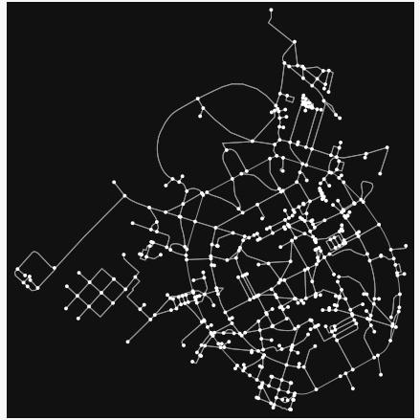
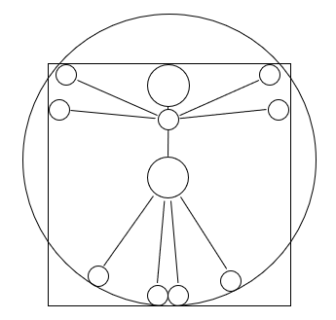

Epidemic Propagation Operators in Meta-populations
José Alejandro Rojas Venegas
Grupo de Sociofísica y Econofísica
Departamento de Física, Facultad de Ciencias
Universidad Nacional de Colombia
Seminario de Redes y Complejidad

Slide 2
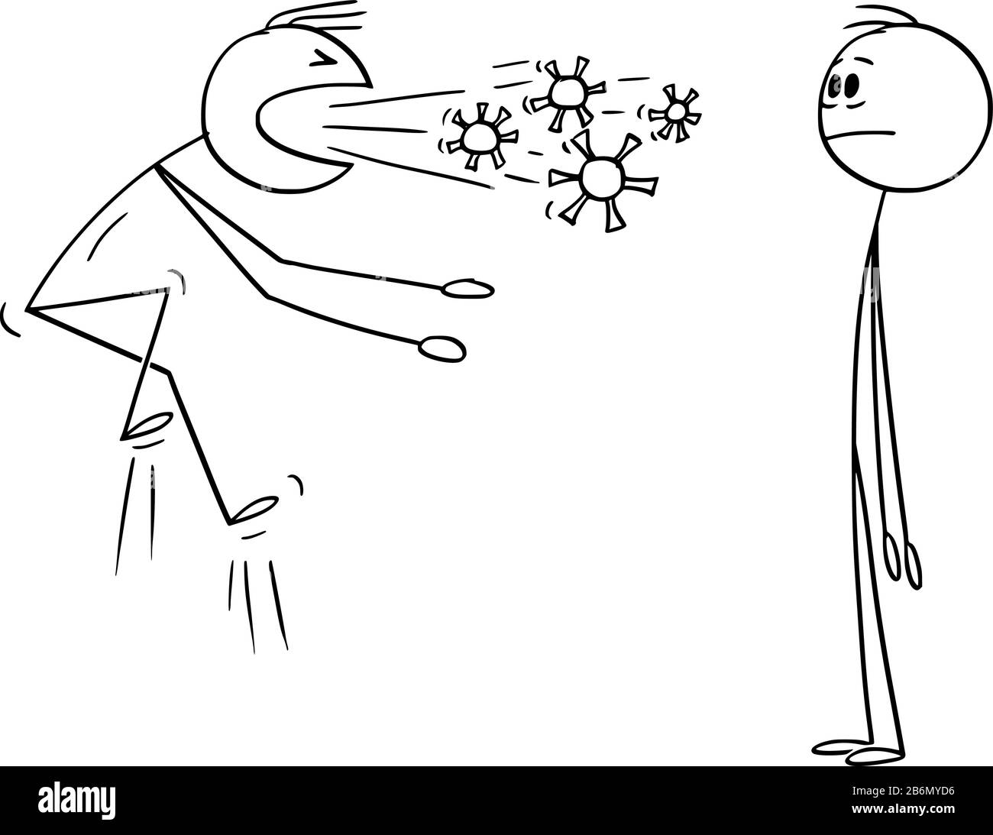
Reaction-Diffusion Processes (RDP)
+
2

Slide 3
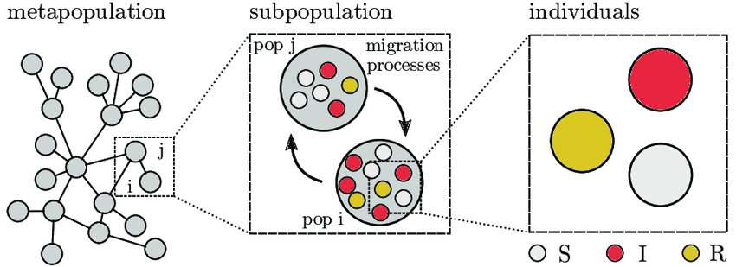
Bosonic Meta-population RDPs
Hackl, J., & Dubernet, T. (2019). Epidemic Spreading in Urban Areas Using Agent-Based Transportation Models. In Future Internet (Vol. 11, Issue 4, p. 92). MDPI AG. https://doi.org/10.3390/fi11040092

Slide 4
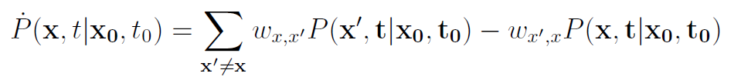
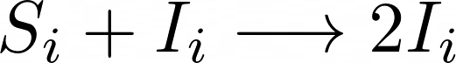
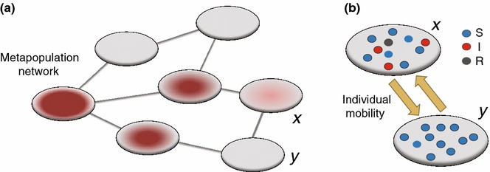
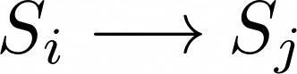
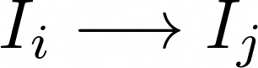
Markovian Master Equations
Wang, L., & Li, X. (2014). Spatial epidemiology of networked metapopulation: an overview. In Chinese Science Bulletin (Vol. 59, Issue 28, pp. 3511–3522). Springer Science and Business Media LLC. https://doi.org/10.1007/s11434-014-0499-8

Slide 5
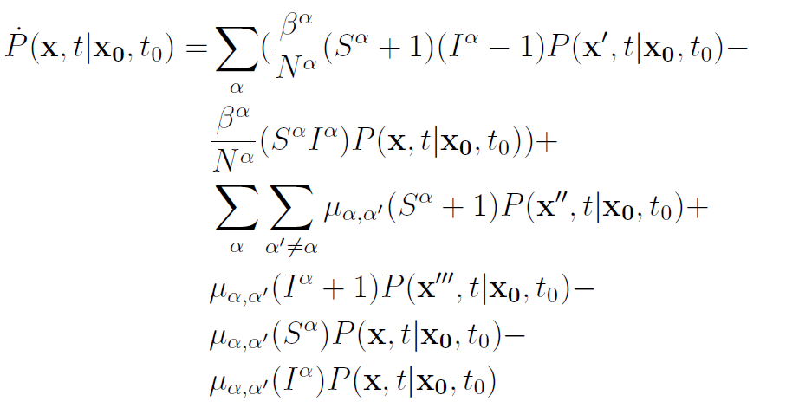
Markovian Master Equations
Wang, L., & Li, X. (2014). Spatial epidemiology of networked metapopulation: an overview. In Chinese Science Bulletin (Vol. 59, Issue 28, pp. 3511–3522). Springer Science and Business Media LLC. https://doi.org/10.1007/s11434-014-0499-8

Slide 6
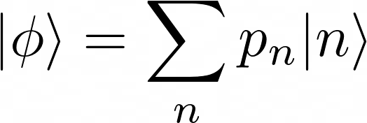
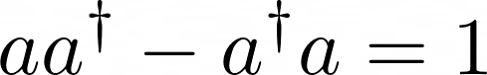
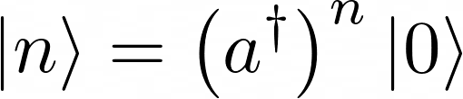
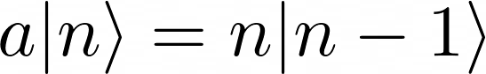
Analytical Approach to RDPs
“phi” state represents the probability of each accessible macroscopic state “n”
Ladder operators are added to built an MME
Peliti, L. (1985). Path integral approach to birth-death processes on a lattice. In Journal de Physique (Vol. 46, Issue 9, pp. 1469–1483). EDP Sciences. https://doi.org/10.1051/jphys:019850046090146900

Slide 7
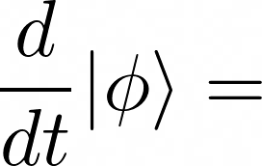
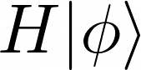
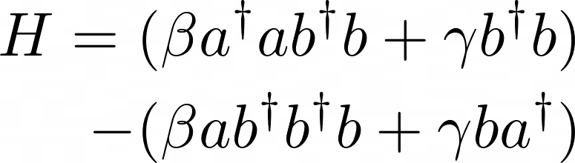
Why Bra-ket
The MME is now a Schrodinger equation in imaginary time
Remember, our interest is to find the dynamics of “phi”
H contains the whole information of the rules of the game. In this case you can see a SIS operator

Slide 8
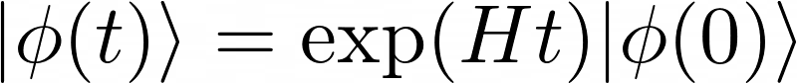
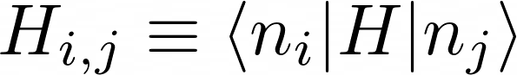
Analytical Solution to the Bosonic RDP
The propagator of the system is the exponential of an operator
To solve this, we need to compute the matrix form of H:

Slide 9
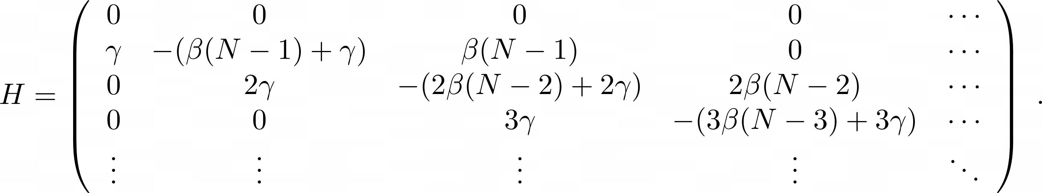
The Matrix Form of SIS Propagator

Slide 10
The Interpretation of H: SIS
I=0
I=1
I=2
I=3
…

Slide 11
The Interpretation of H
S=1000
I=0
R=0
S=999
I=1
R=0
S=998
I=2
R=0
S=997
I=3
R=0
…
S=999
I=0
R=1
S=998
I=1
R=1
S=997
I=2
R=1
…
S=998
I=0
R=2
S=997
I=1
R=2
…
S=997
I=0
R=3
…

Slide 12

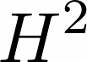
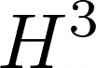
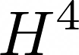
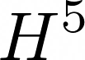
Path Length Matrices
S=999
I=1
R=0
S=998
I=2
R=0
S=997
I=3
R=0
S=999
I=0
R=1
S=998
I=1
R=1
S=997
I=2
R=1
S=998
I=0
R=2
S=997
I=1
R=2
S=997
I=0
R=3

Slide 13
Path Length Matrices
S=999
I=1
R=0
S=998
I=2
R=0
S=997
I=3
R=0
S=999
I=0
R=1
S=998
I=1
R=1
S=997
I=2
R=1
S=998
I=0
R=2
S=997
I=1
R=2
S=997
I=0
R=3

Slide 14

The –familiar- Communicability of H (or Ht)

Slide 15
The –familiar- Communicability of H (or Ht)
Caminos globales de
orden 0
Caminos globales de
orden 2
Caminos globales de
orden 4
Caminos globales de
orden 1
Caminos globales de
orden 3
Caminos globales de
orden 5

Slide 16
Creating Operator Locality
As this Master Equation is Markovian:
t=0
t=t_1
t=t_2
t’=t
t’=t+dt
t’=t+dt+dt

Slide 17
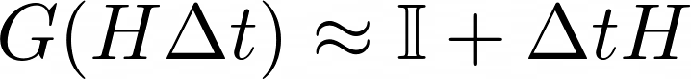
God Bless Locality
Caminos locales de
orden 0
Caminos locales de
orden 2
Caminos locales de
orden 4
Caminos locales de
orden 1
Caminos locales de
orden 3
Caminos locales de
orden 5
If Δt is sufficiently small, the jumps are local (at order 1 maximum), and the communicability becomes:

Slide 18
The Communicability of H Δt
By using the locality of the evolution rules and a network representation, the evolution can be approximated to:

Slide 19
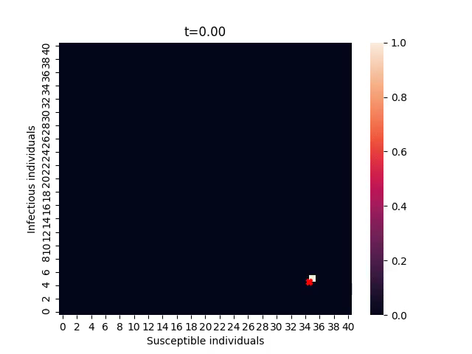

Testing Locality - SIR

Slide 20
Scalability
System | Dim(H)
SIS, N=10 | 11
SIR, N=10 | 121
SIS, N=1000 | 1001
SEIR, N=10 | 1331
SIR, N=100 | 10 201
SEIR, N=40 | 68 921
Metapopulation SIR, 10 nodes, N_i=10 | 12 x 10^40
Scalability grows as (N+1)^m where m is the total number of “reactants” and N ins the number of individuals

Slide 21



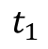
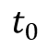
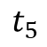
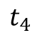
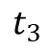
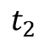
How to Solve Scalability: Tau Leap Sampling
If sampling rules for the MME are created and enough trajectories are generated, the phase space probability could be reconstructed.
$$t_{0}$$
$$t_{1}$$
$$t_{2}$$
$$t_{3}$$
$$t_{4}$$
$$t_{5}$$

Slide 22
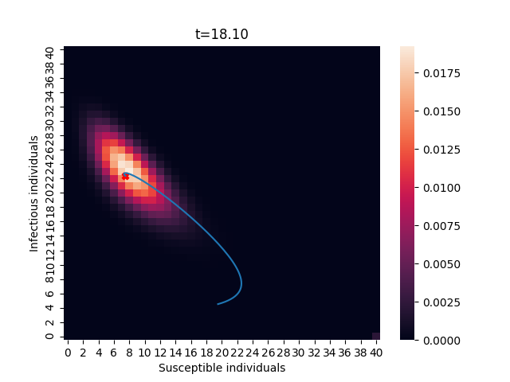
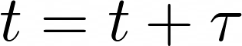

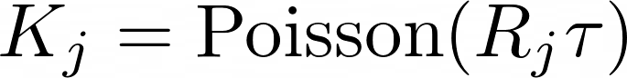
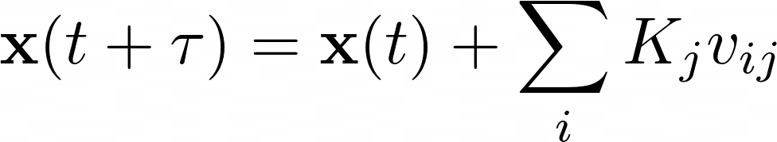
How to Solve Scalability: Tau Leap Sampling
Start
Define initial conditions and parameters
Calculate propensities (R_j)
Sample
Update the states as:

Slide 23

Tau leap
Analytic solution

Slide 24



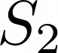
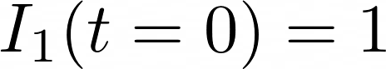
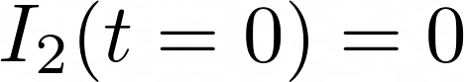
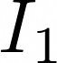
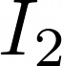
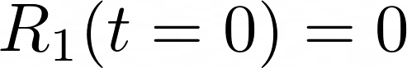
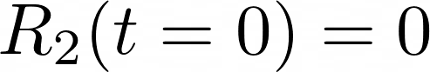
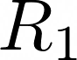
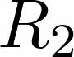
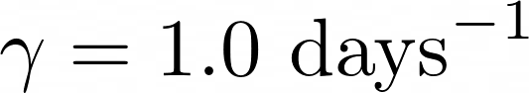
Simplest Network Simulation and Complexity

Slide 25
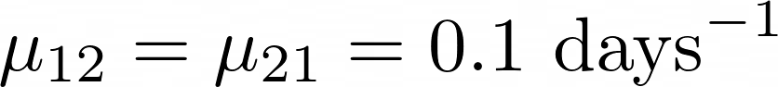
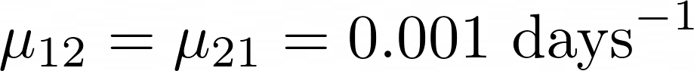
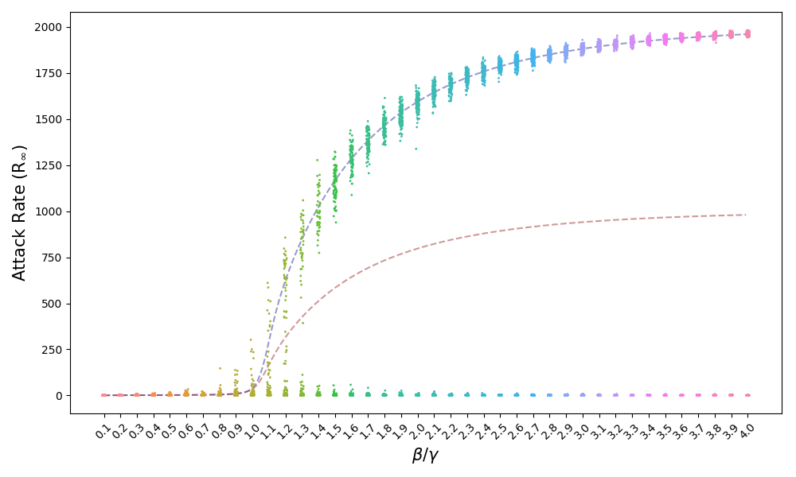
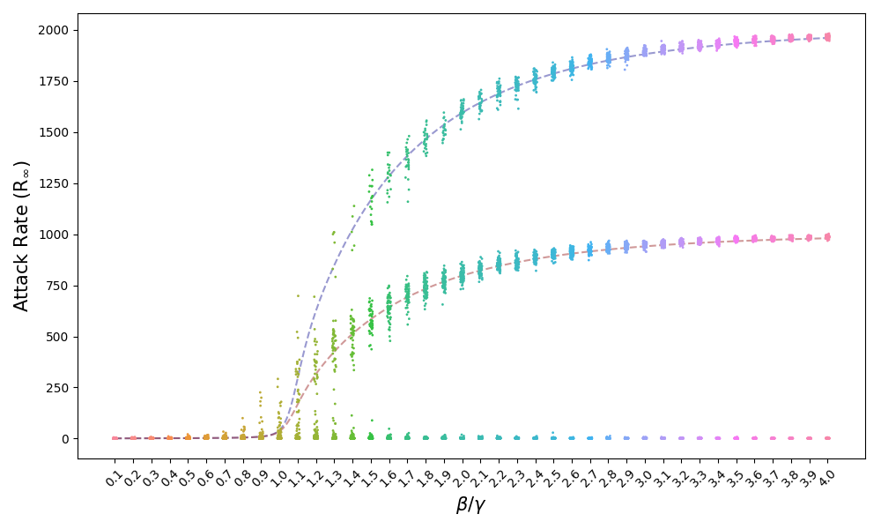
Stationary States

Slide 26




Stationary States
La movilidad asimétrica puede romper los estados estables fijos del modelo bien mezclado, pero no la posible multiestabilidad.

Slide 27

Small Systems: Migration

Slide 28
Take Home Messages
+ Reaction diffusion systems do have an analytic solution if they are specifically written as a Markovian Master Equation; but the properties of this solutions are hard to get out, neither brute force nor field theory can get this properties for large number of subpopulations.
+ By adding bosonic migration to RDPs we can find multi-stable distributions, well-mixed state breaking and extreme differences in the probability cloud dynamics.

Slide 29


